Slide 1
Lecture 6
CS404: Software Engineering
Software Requirement Specification and Analysis
Software Engineering: A Practitioner’s Approach, 7/e
by Roger S. Pressman
Slides copyright © 1996, 2001, 2005, 2009 by Roger S. Pressman
Software Engineering 9/e
By Ian Sommerville

Slide 2
Contents
Requirements Analysis Models
Scenario Based Models
Usage Scenario
Use Case Diagrams
Activity Diagrams

Slide 3
Requirements Analysis Models
Mainly 4 Types of Requirements Analysis Models:
Scenario Based Models
Data Based Models
Class Based Models
Behavioral Models
There are also Data Flow Models

Slide 4
Contents
Requirements Analysis Models
Scenario Based Models
Usage Scenario
Use Case Diagrams
Activity Diagrams

Slide 5
Scenario Based Models
3 Types of modelling should be specified:
Usage Scenario
Use Case Diagrams
Activity Diagrams

Slide 6
Contents
Requirements Analysis Models
Scenario Based Models
Usage Scenario
Use Case Diagrams
Activity Diagrams

Slide 7
Usage Scenario
Provide a detailed description of the system
Must be in paragraphs
Must be comprehensive
Must avoid ambiguity

Slide 8
Usage Scenario (Example)
The ATM system has two types of users. Admin and customer. The admin can add money to the ATM machine from the bank and if he wishes, he can also withdraw money like a customer. A customer can only withdraw money from the ATM. To withdraw money, the user must first enter his ATM card into the machine. Upon entering the ATM card, the machine will show the user some preset values to withdraw (500 BDT, 1000 BDT, 5000 BDT, 10000 BDT, 20000 BDT). The user will then choose which value he wants to withdraw. The system will then check if the user has enough money in his account to make the withdrawal. If so, it will deduct the amount from the user’s bank account and disburse it in cash. Otherwise, the machine will provide an error message saying “YOU DON’T SUFFICIENT BALANCE TO MAKE THAT TRANSACTION. PLEASE TRY A SMALLER AMMOUNT.”

Slide 9
Contents
Requirements Analysis Models
Scenario Based Models
Usage Scenario
Use Case Diagrams
Activity Diagrams

Slide 10
Use Case Diagrams
Use case diagrams consist of actors and the system:
Two Types of actors:
Primary Actors (Provides input and consumes output)
Secondary Actors (only consumes output)

Slide 11
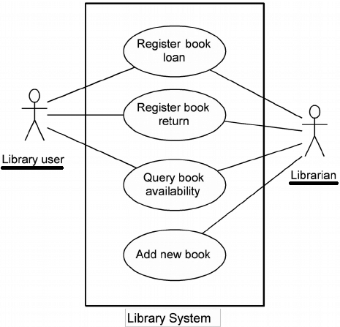
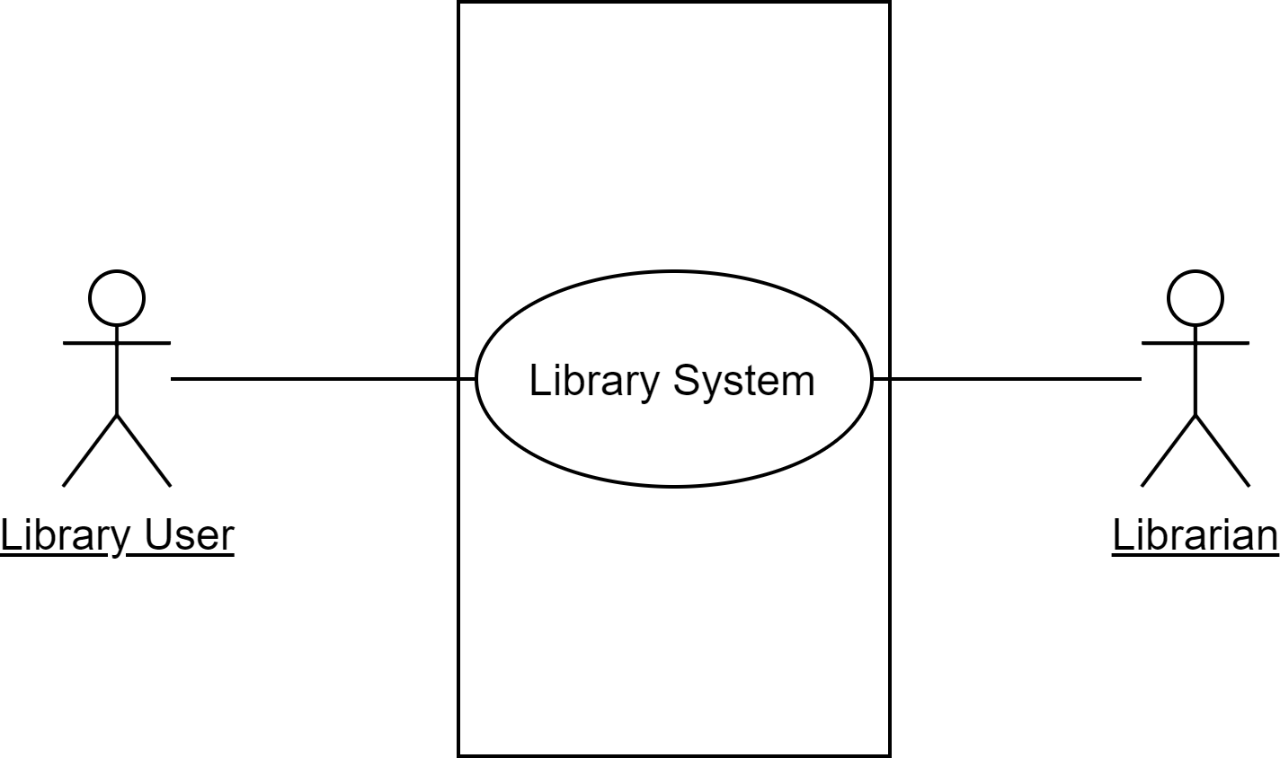
Use Case Diagrams (Example)
Level 0 Use Case Diagram
Level 1 Use Case Diagram

Slide 12
Contents
Requirements Analysis Models
Scenario Based Models
Usage Scenario
Use Case Diagrams
Activity Diagrams

Slide 13
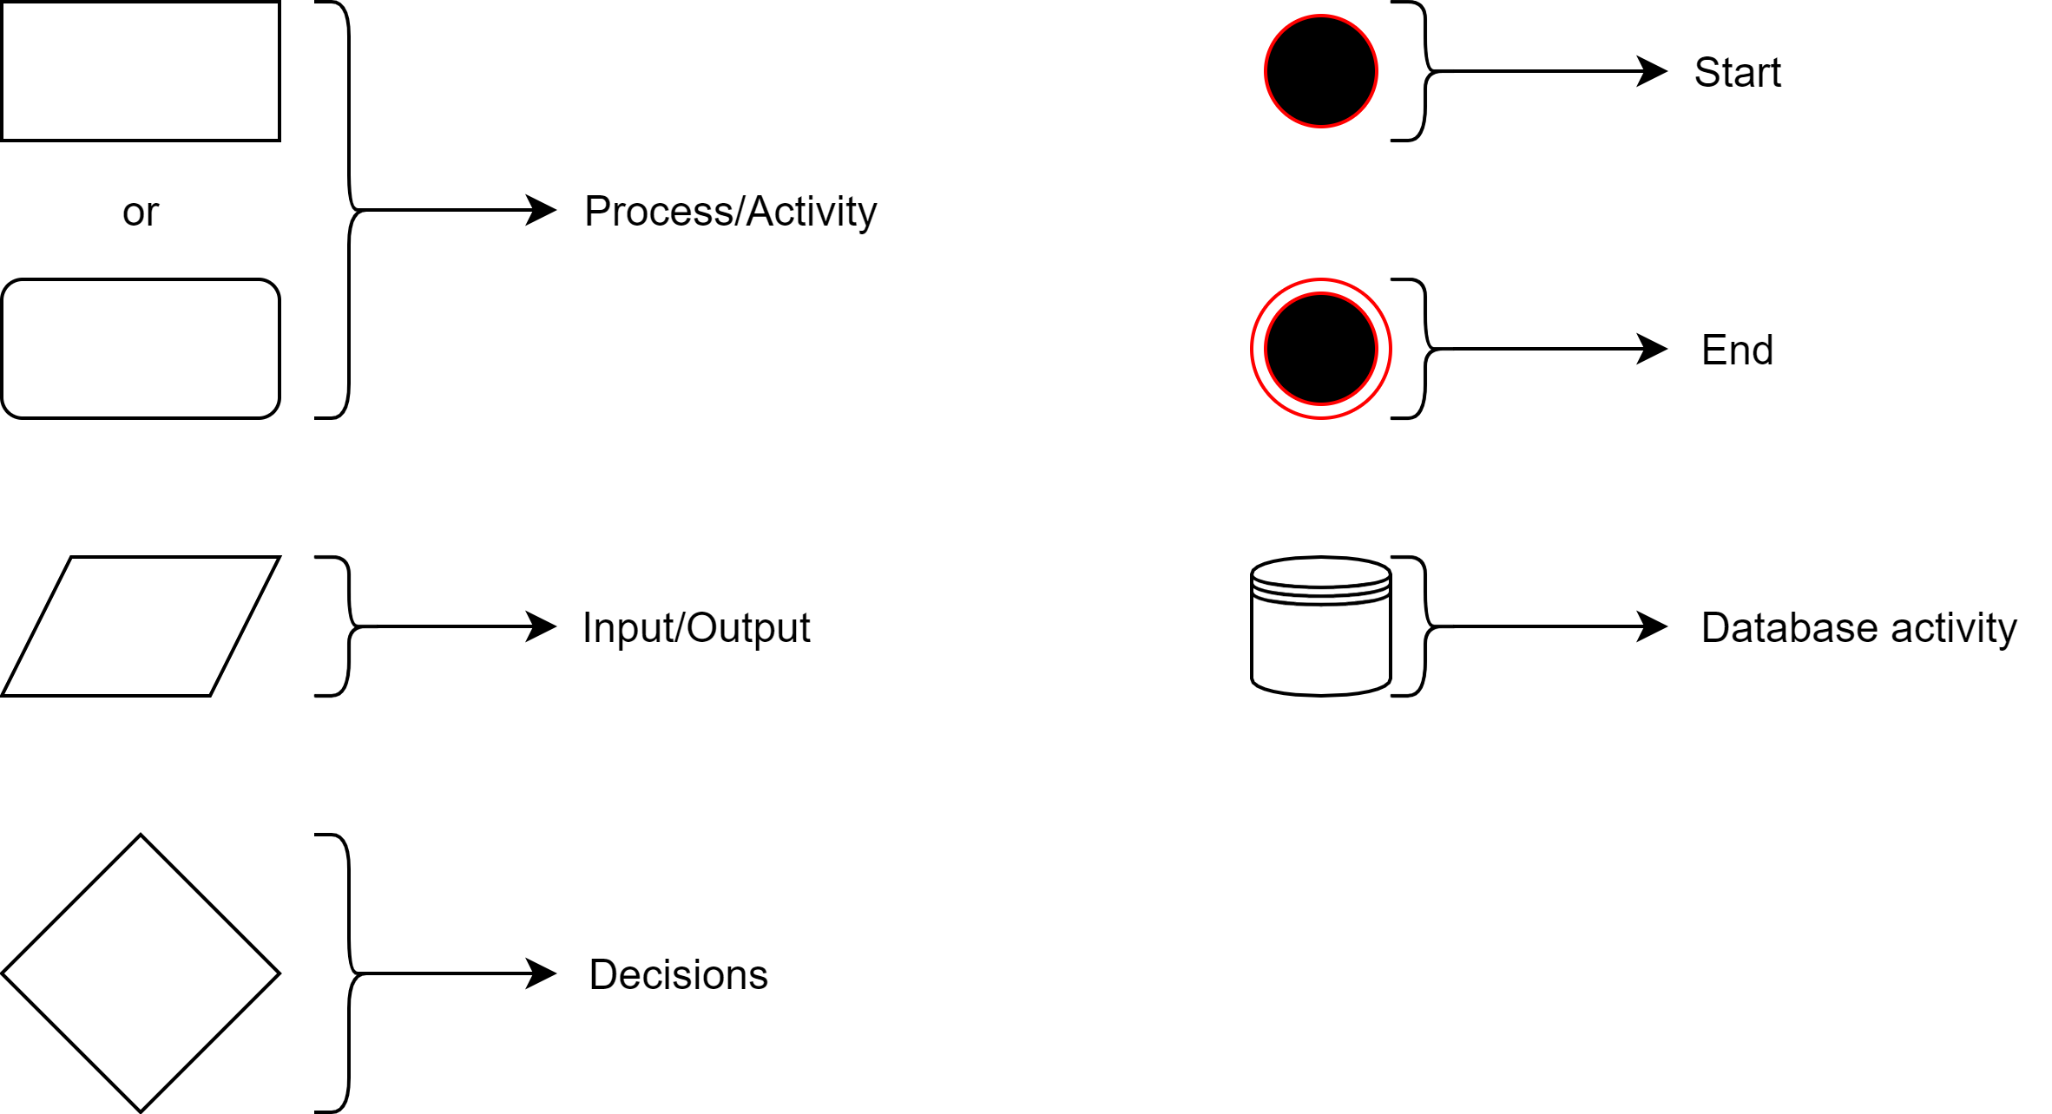
Activity Diagrams
Mostly like a flowchart
The following symbols are used in their given meaning

Slide 14
End of lecture 6

